Slide 1
The Stored-Program Concept Done by: Kyler Brown
FPPT.com

Slide 2
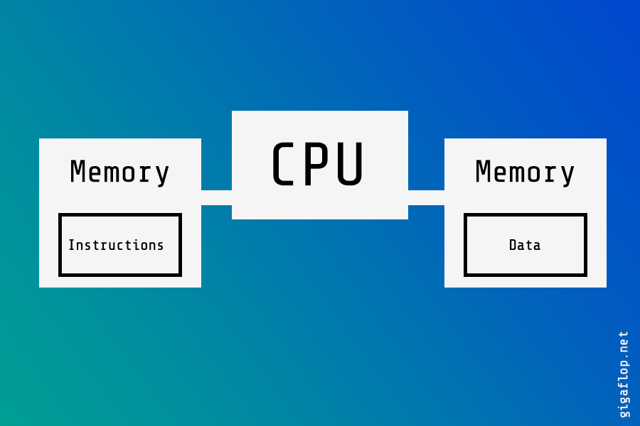
What is the Stored program concept?
The stored program concept relates to program instructions being stored in main memory.
When a computer uses the stored program concept, the contents of a memory location can be interpreted as either instructions or data.

Slide 3
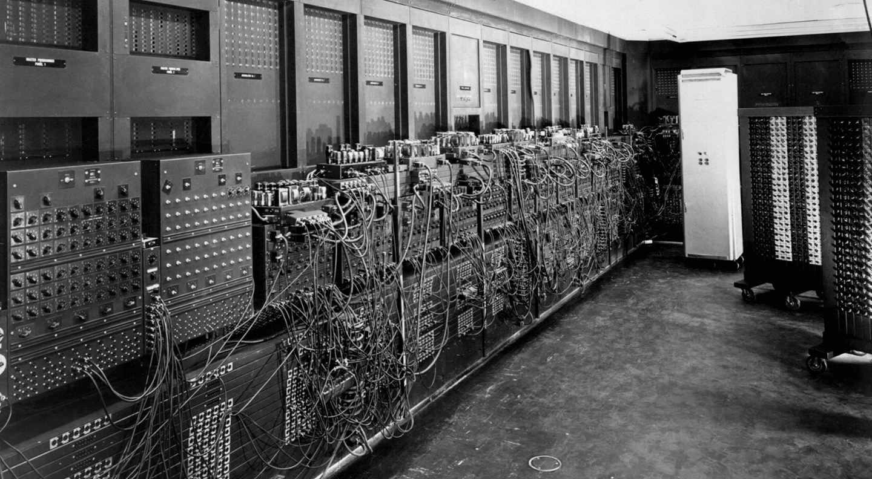
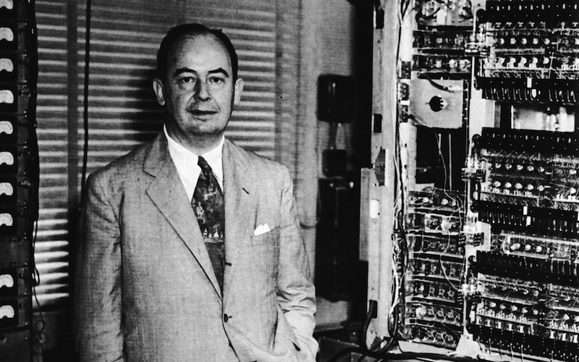
A Brief history of the stored program concept

Slide 4
The step-by-step process of Main Memory
Term | Meaning
Serially | Instructions are fetched and executed (see below) in order. The first instruction is fetched and then executed before the second instruction is fetched.
Fetching | Retrieving an instruction from main memory.
Executing | Carrying out what is specified by the instruction that has been fetched.
Machine code instructions | Instructions formed from just 1s and 0s that the processor can execute directly without the need for translation.
Main memory | Where a computer stores instructions and frequently used data. Examples include RAM and ROM.
Arithmetic | Operations that involve mathematical operations such as addition, subtraction and multiplication.
Logical | Operations that involve the use of logic gates like AND, OR and NOT

Slide 5
The Stored Program Concept can be further classified in three basic ways:
The Von-Neumann Model
The General Purpose system
Parallel Processing

Slide 6
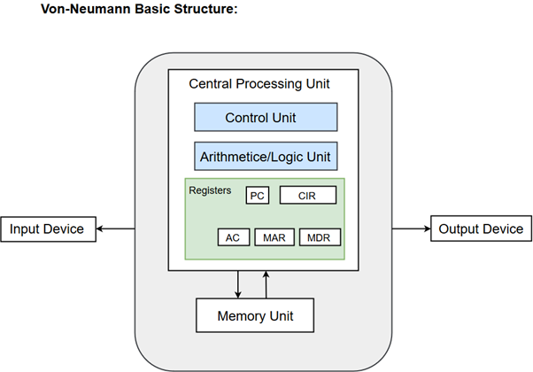
The Von-Neumann Model
Uses s single processor
Uses one memory for both instructions and data
Executes programs following the fetch-decode-execute cycle

Slide 7
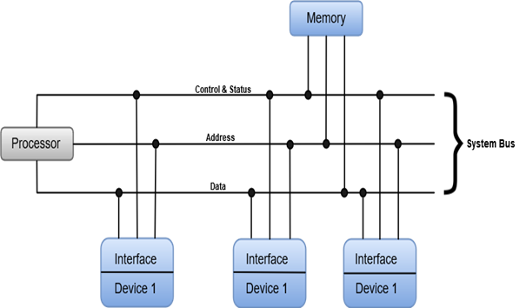
The General-Purpose system

Slide 8
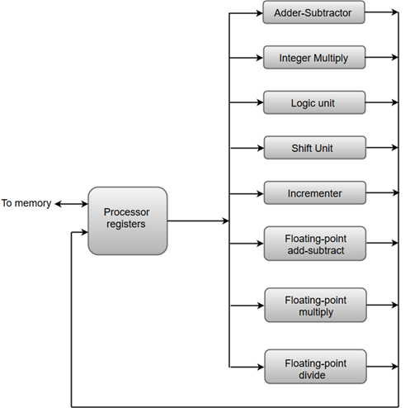
Parallel Processing
The adder and integer multiplier performs the arithmetic operation with integer numbers.
The floating-point operations are separated into three circuits operating in parallel.
The logic, shift, and increment operations can be performed concurrently on different data. All units are independent of each other, so one number can be shifted while another number is being incremented.

Slide 9
The Stored Program Concept Uses
Abbreviated dialing
Call forwarding
Call waiting

Slide 10
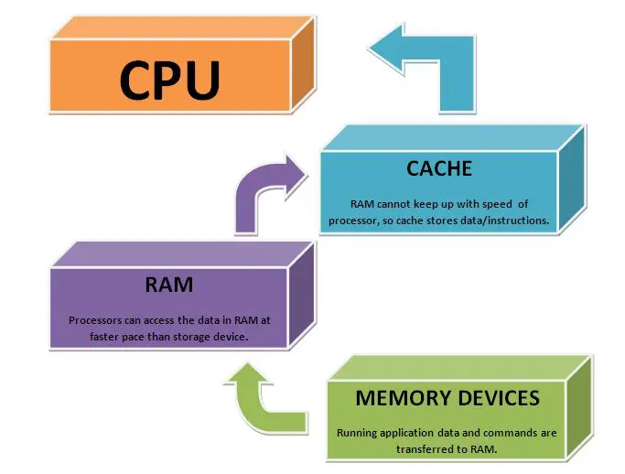
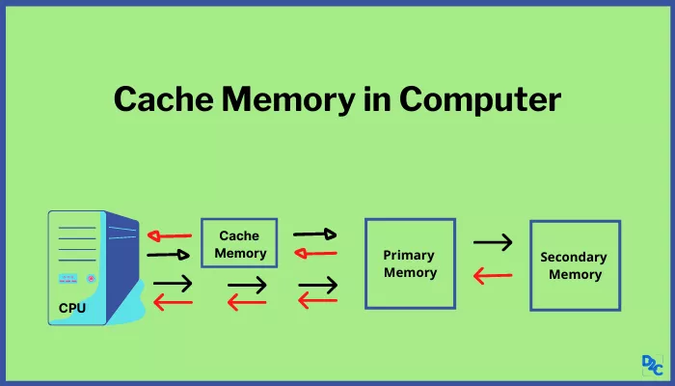
Cache Memory

